Slide 1


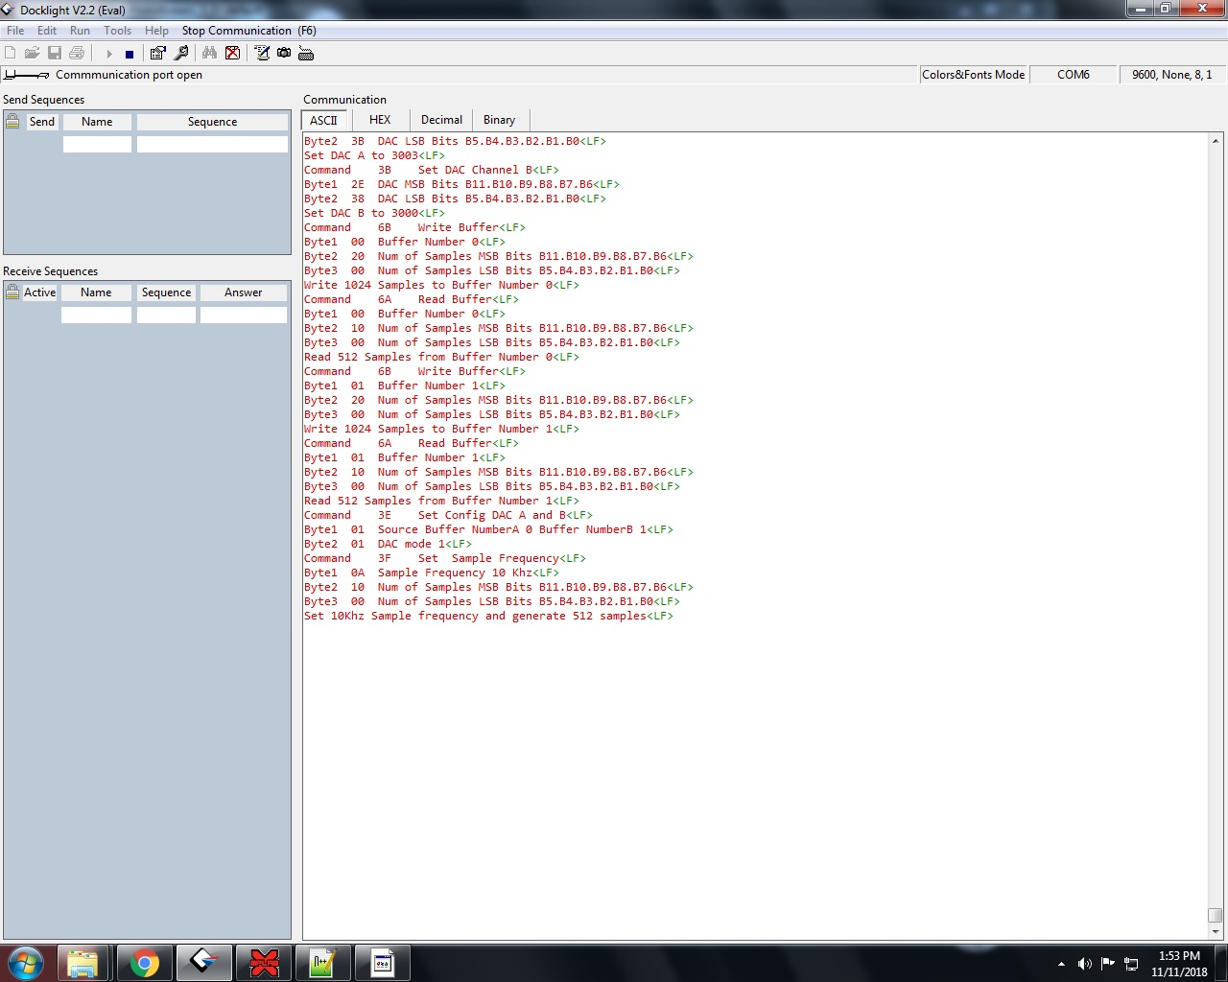

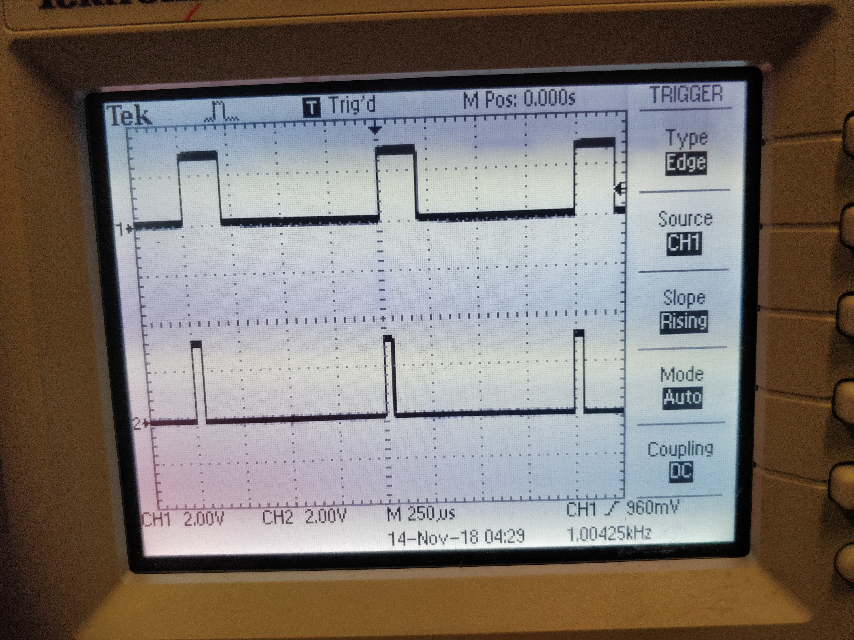
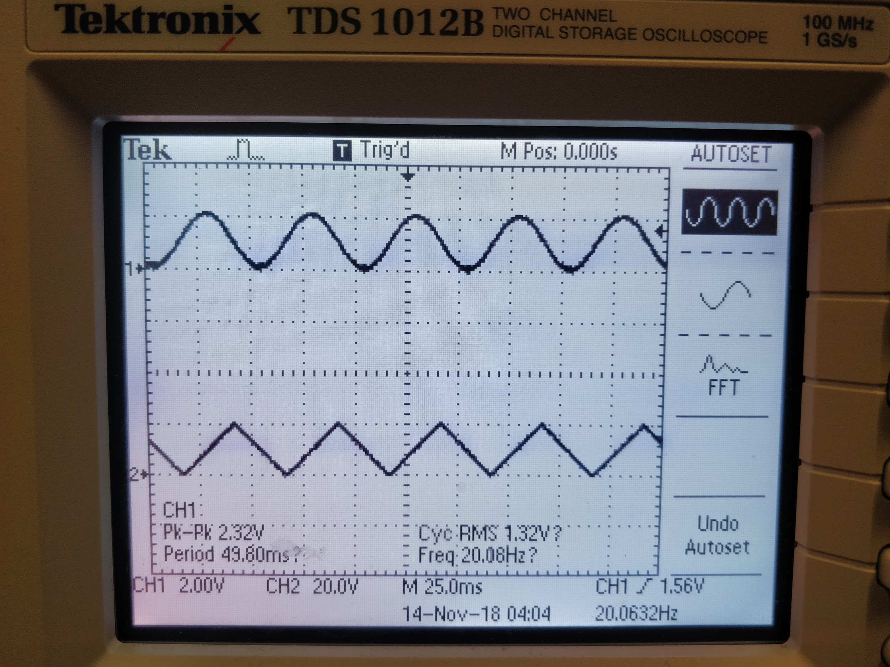
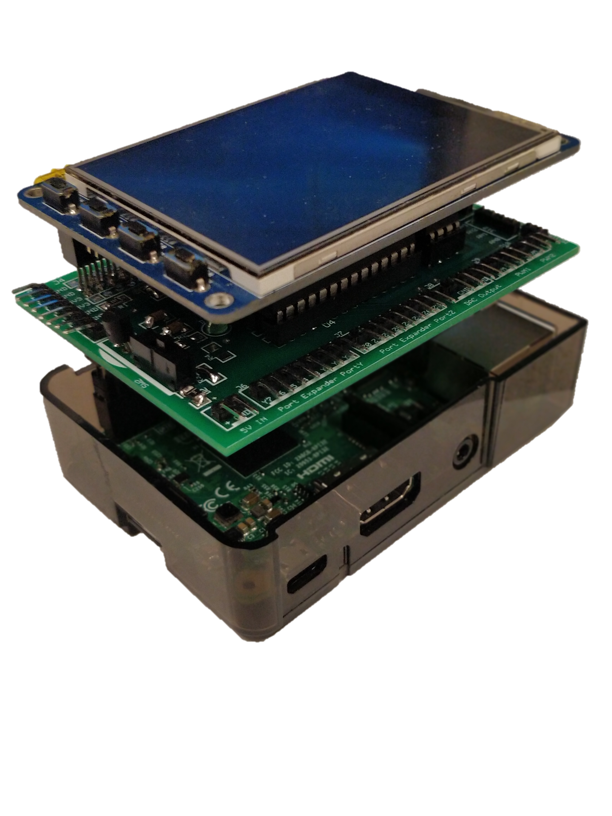

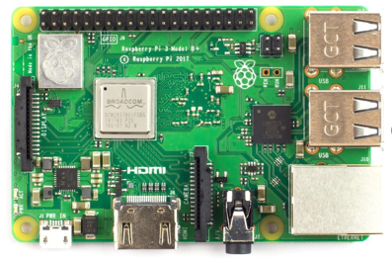
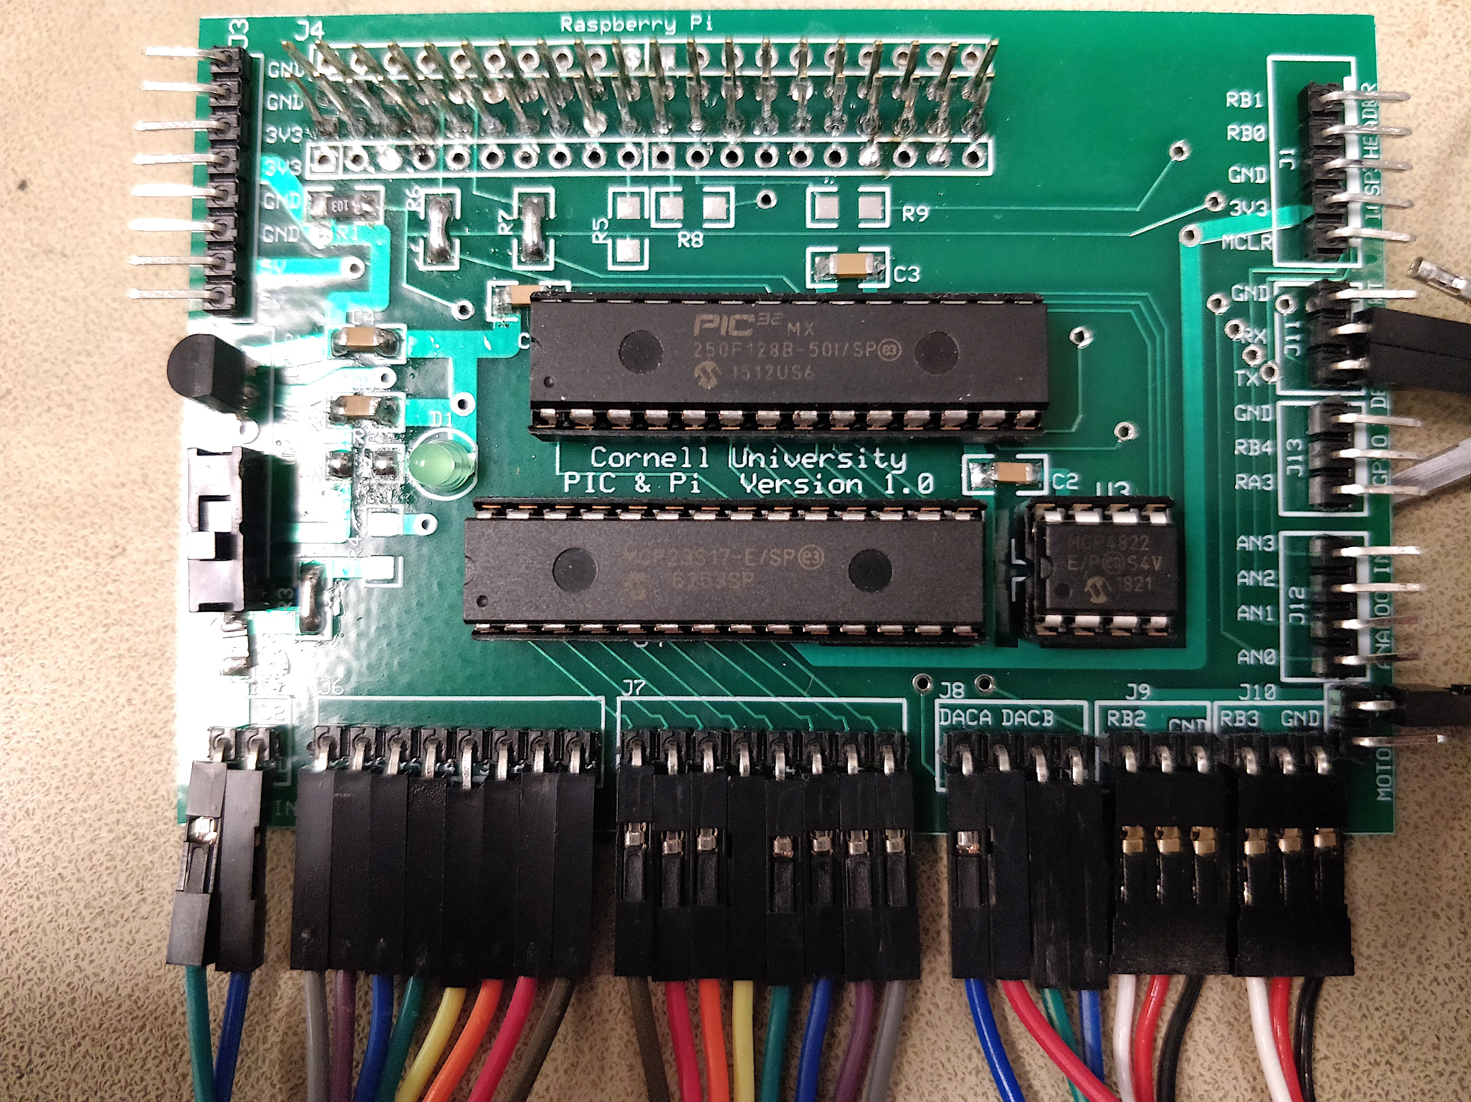
Authors: Vipin Venugopal, Ye Kuang Advisors: Dr. Bruce Land, Dr. Joseph Skovira
PIC32 and Raspberry Pi Interface
Combine real time PIC32 & powerful Raspberry Pi
RPi callable set of PIC32 peripheral control functions
Tested OK ✓
Read input
Write output
Set Value for CHA
Set Value for CHB
Check Buffer Status
Set Sample Frequency
Start ADC
Set Period
Generate PWM 1
Generate PWM 2
Read Buffer
Write Buffer
Serial Communication
✔︎ Serial Comm
✔︎ PWM
✔︎ DAC Waveform
✔︎ GPIO Control
✔︎ ADC Sampling
✔︎ Data Transfer
Develop a cross platform system capable of performing real time tasks
Use Embedded Operating System to Enable development of software decoupled from the hardware
Implement a final application to demonstrate the system.
PIC + RPi = Real-time + Cool Linux stuff
PWM Generation
DAC Waveform
PIC32: Real-time input reading, analog interface and output generation
Raspberry Pi: Linux operating system, fast decision making, higher level software, user-interface and connectivity
Analog
Port Expander
Proof of concept: Autonomous suitcase
PWM
DAC
Built a people following robot with the system
Raspberry Pi processes vision information and controls where to go
PIC32 follows Raspberry Pi’s order and generates PWM to control motors
RPi ←high speed→ PIC32
RS232 Debug
Raspberry Pi works as “master”, making decisions and controls PIC32, performs higher level tasks such as image processing
Pic32 works as “slave”, receiving command from Raspberry Pi and performs lower level tasks such as PWM generation
RPi
PIC32 PCB mates with RPi
Master :
Performs higher level tasks
Best of both worlds!
Pi
Response
The combination of PIC32 and Raspberry Pi makes it possible for building a system with blazing fast low level functionality and a full fledged operating system
The communication protocol is universal and flexible, one can build anything with this protocol
The cost of the system is low
Command
Slave :
Performs lower level tasks
PIC
Thanks to Dr. Bruce Land & Dr. Joseph Skovira!

